Slide 1
Multilayer Perceptron
Prakash P VIT , Chennai

Slide 2
Road Map
Multilayer Perceptron
Representation Power of a Network of Perceptrons

Slide 3
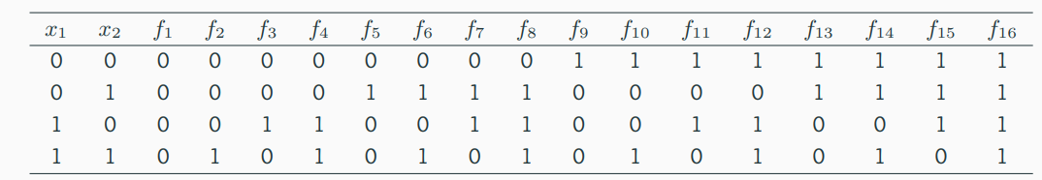

Linearly Separable Boolean Functions
How many boolean functions can you design from 2 inputs ?
In general, how many boolean functions can you have for n inputs ?

Slide 4
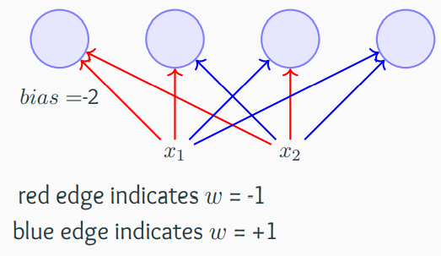
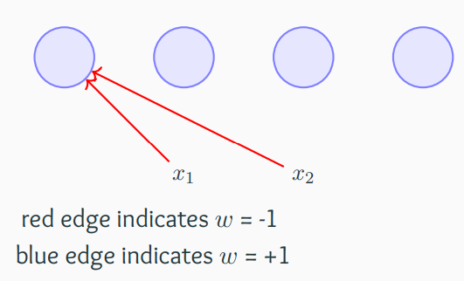
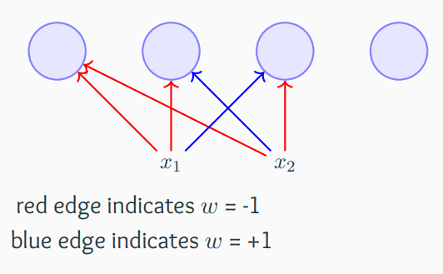
Representation Power of a Network of Perceptrons
The bias (w₀) of each perceptron is -2 (i.e.,
each perceptron will fire only if the weighted
sum of its input is ≥ 2)
Assume True = +1 and False = -1
Consider 2 inputs and 4 perceptrons
Each input is connected to all the 4 perceptrons with specific weight

Slide 5
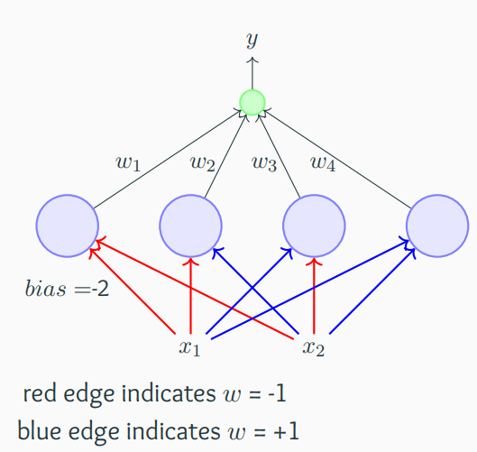
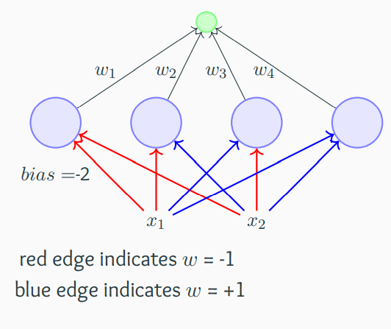
Representation Power of a Network of Perceptrons
Each of these perceptrons is connected to an
output perceptron by weights (which need to
be learned)
The output of this perceptron (y) is the output of this network

Slide 6
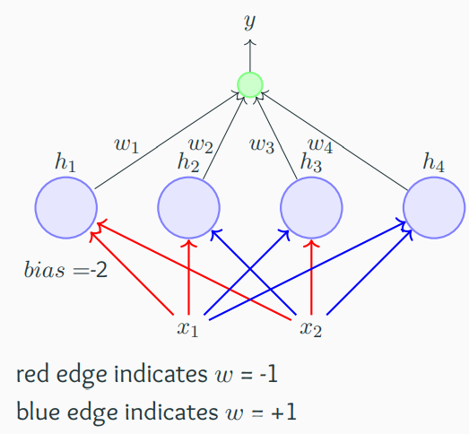
Representation Power of a Network of Perceptrons
This network contains 3 layers
Terminology Alert !!!
The layer containing the inputs (x1, x2) is
called the input layer
The middle layer containing the 4 perceptrons
is called the hidden layer
The final layer containing one output neuron is called the output layer
The outputs of the 4 perceptrons in the hidden layer are denoted by h₁, h₂, h₃, h₄
The red and blue edges are called layer 1 weight
w₁, w₂, w₃, w₄ are called layer 2 weights

Slide 7
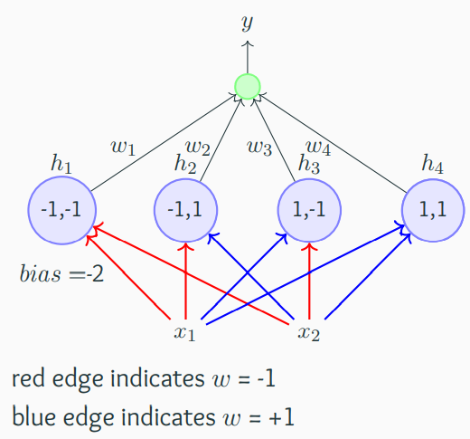

Representation Power of a Network of Perceptrons
Each perceptron in the middle layer fires only
for a specific input (and no two perceptrons
fire for the same input)
the first perceptron fires for {-1,-1}
the second perceptron fires for {-1,1}
the third perceptron fires for {1,-1}
the fourth perceptron fires for {1,1}

Slide 8


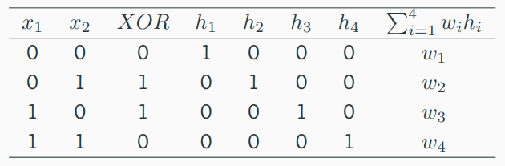
Example of the XOR function
This results in the following four conditions to implement XOR: w₁ < w₀, w₂ ≥ w₀, w₃ ≥w₀, w₄ < w₀
Unlike before, there are no contradictions now and the system of inequalities can be satisfied

Slide 9
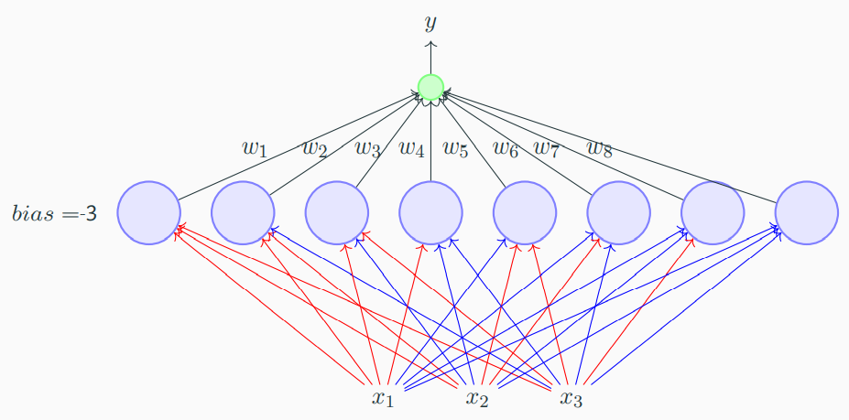
What if we have more than 3 inputs ?
Again each of the 8 perceptorns will fire only for one of the 8 inputs
Each of the 8 weights in the second layer is responsible for one of the 8 inputs and can be adjusted to produce the desired output for that input
What if we have n inputs ?
Any boolean function of n inputs can be represented exactly by a network of perceptrons containing 1 hidden layer with 2^{n} perceptrons and one output layer containing 1 perceptron

Slide 10
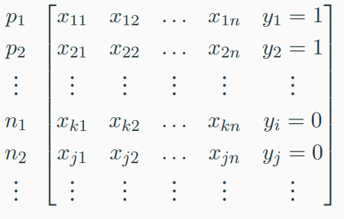
Example
Given this data about our past movie experience
For each movie, we are given the values of the various factors (x1, x2, . . . , xn) that we base our decision on and we are also also given the value of y (like/dislike)
p_{i} ’s are the points for which the output was 1 and n_{i} ’s are the points for which it was 0
The data may or may not be linearly separable
It is possible to have a network of perceptrons and learn the weights in this network such that for any given p_{i} or n_{j} the output of the network will be the same as y_{i} or y_{j} (i.e., we can separate the positive and the negative points)
Networks of the form that we just saw (containing, an input, output and one or more hidden layers) are called Multilayer Perceptrons (MLP, in short) /”Multilayered Network of Perceptrons”

Slide 11
References
https://www.cse.iitm.ac.in/~miteshk/CS6910.html#schedule
https://machinelearningmastery.com/neural-networks-crash-course/

Slide 12
Thanks

